Slide 1
YogaTrainer Using PoseNet
By
Ashutosh Mishra (1905600)
Pratyush Aanand (1905189)

Slide 2
What is PoseNet?

Slide 3
PoseNet
Google’s TensorFlow’s Pose NET
Is a pretrained opensource model created by TensorFlow team at google.
vision technique which identifies joints in human body using convolution neural network, it doesn’t exactly identify a person, just their joints
runs on Tensorflow.js
Types of Pose net
1. Single person detector
2. Multiple person detector

Slide 4
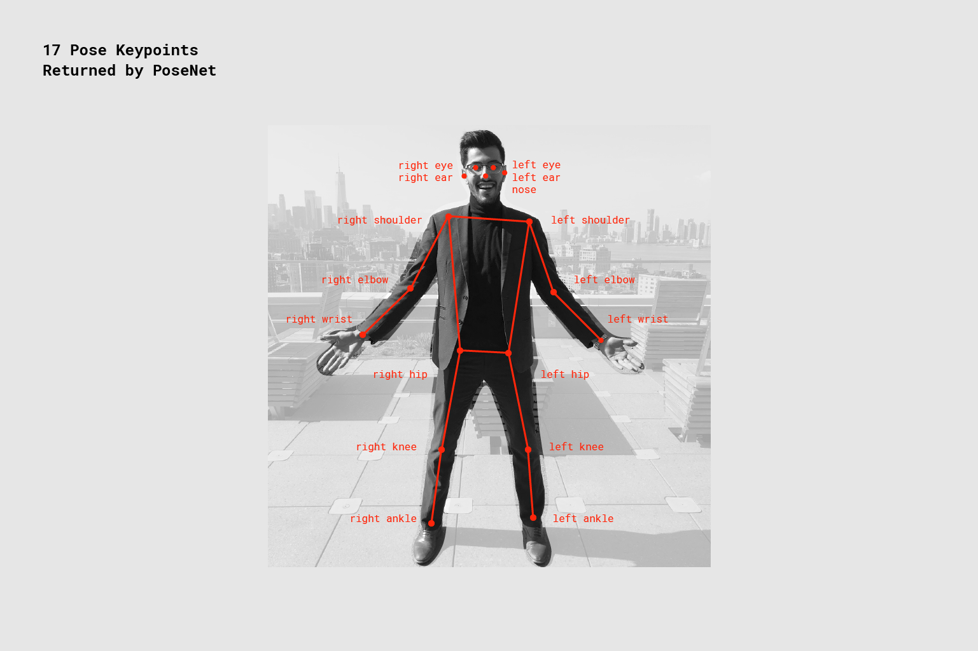
What does it identify?
1. Right Eye 2. Left Eye 3. Right Ear 4. Left Ear 5. Nose 6. Right Shoulder 7. Left Shoulder 8. Right Elbow 9. Left Elbow 10.Right Wrist 11. Left Wrist 12. Right Hip 13. Left Hip 14. Right Knee 15. Left Knee 16. Right Ankle 17. Left Ankle

Slide 5
How do we use?
Using JavaScript Script library
P5.js for creative coding
ML5.js – JavaScript machine learning model

Slide 6
P5.js
p5.js is a JavaScript open source library for creative coding, with a focus on making coding accessible and inclusive for artists, designers, educators, beginners, and anyone else!
Using the metaphor of a sketch, p5.js has a full set of drawing functionality. However, you’re not limited to your drawing canvas. You can think of your whole browser page as your sketch, including HTML5 objects for text, input, video, webcam, and sound.
It employs two basic function to enjoy its capability
Setup () function
Draw () function

Slide 7
Setup function
The setup() function is called once when the program starts. It's used to define initial environment properties such as screen size and background color and to load media such as images and fonts as the program starts. There can only be one setup() function for each program and it shouldn't be called again after its initial execution.
Variables declared within setup() are not accessible within other functions, including draw().

Slide 8
Draw function
This function run continuously
Used to draw something on the webpage
Here we will draw a artificial skeleton
Called directly after setup(), the draw() function continuously executes the lines of code contained inside its block until the program is stopped or noLoop() is called. Note if noLoop() is called in setup(), draw() will still be executed once before stopping. draw() is called automatically and should never be called explicitly.
It should always be controlled with noLoop(), redraw() and loop(). After noLoop() stops the code in draw() from executing, redraw() causes the code inside draw() to execute once, and loop() will cause the code inside draw() to resume executing continuously.
The number of times draw() executes in each second may be controlled with the frameRate() function.
There can only be one draw() function for each sketch, and draw() must exist if you want the code to run continuously, or to process events such as mousePressed(). Sometimes, you might have an empty call to draw() in your program, as shown in the above example.
It is important to note that the drawing coordinate system will be reset at the beginning of each draw() call. If any transformations are performed within draw() (ex: scale, rotate, translate), their effects will be undone at the beginning of draw(), so transformations will not accumulate over time. On the other hand, styling applied (ex: fill, stroke, etc) will remain in effect.

Slide 9
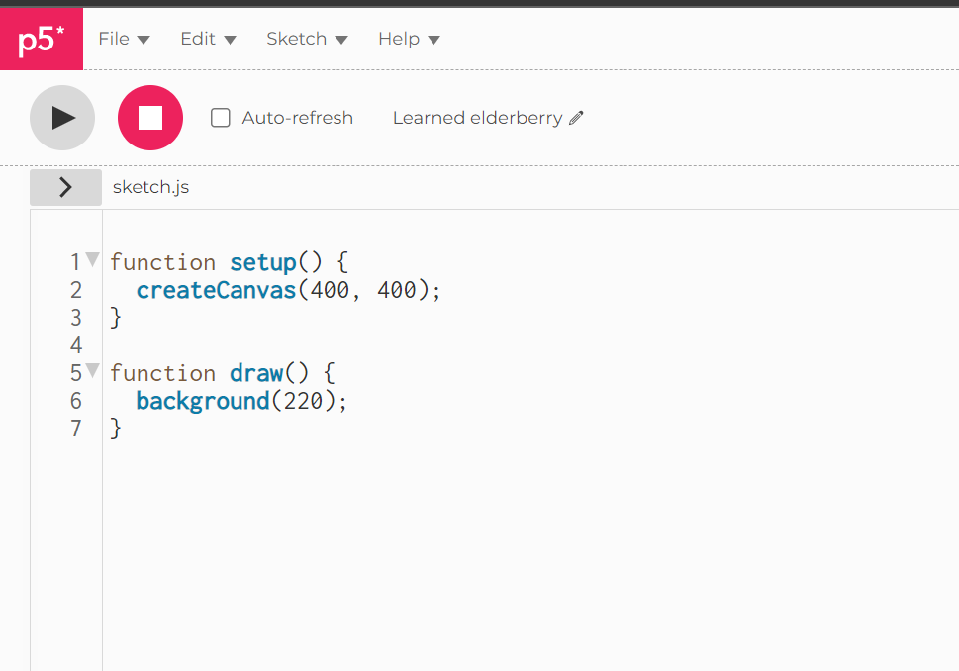
Basic ps5 code

Slide 10
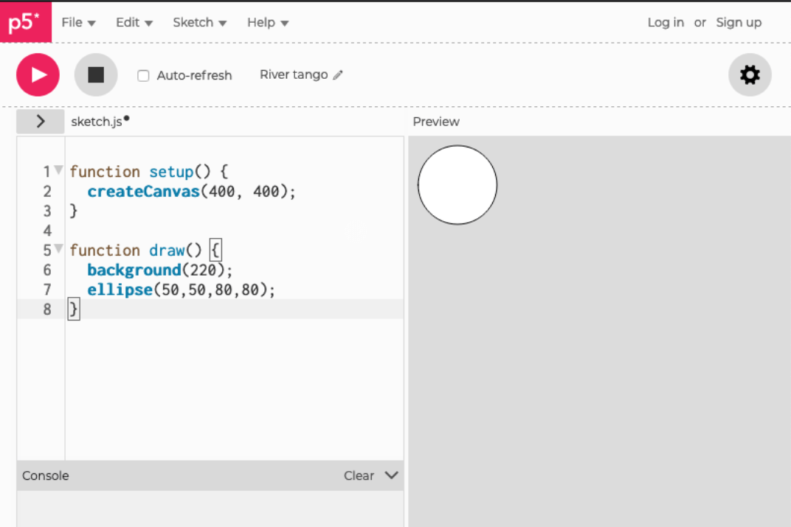
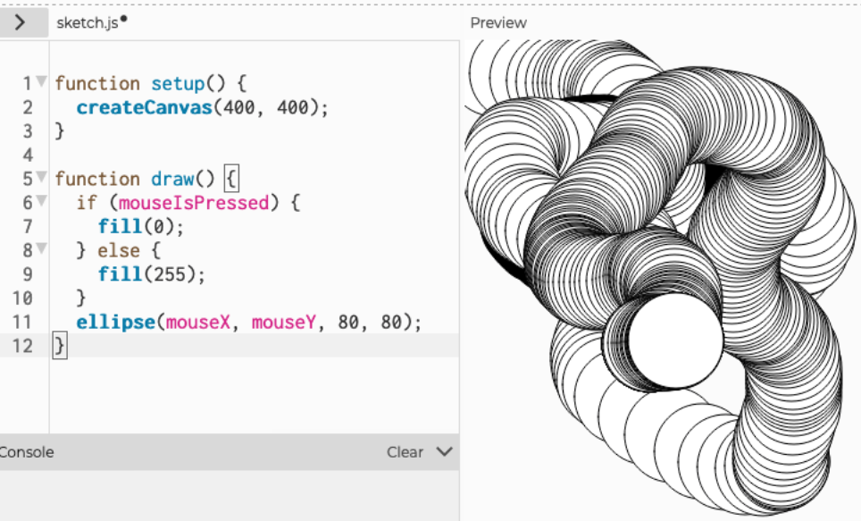
Capabilities

Slide 11


Webcam
This function will allow the webpage to capture the video through the camera. It returns a video object
It will be written in setup function
This argument will present the video feed on the canvas of webpage.
It will be written in draw function

Slide 12

ML5
ml5.js aims to make machine learning approachable for a broad audience of artists, creative coders, and students. The library provides access to machine learning algorithms and models in the browser, building on top of TensorFlow.js with no other external dependencies.
All ML5 function are called using the syntax using ML5.function_name()
We will call posenet using the ml5 library and provide it our video feed and callback function as argument.

Slide 13
How to draw a skeleton
Input to the posenet is image that we are feeding it (in our case webcam image)
Then it process it and returns output
The output of posenet is an object by the name of ‘poses’.
It’s in the form of an array which will have following elements
1. pose
1. score
2. Keypoints : x,y and confidence score
2. skeleton
3. confidence score of the entire pose

Slide 14
How to draw a skeleton (contd.)
Ml5 is used to initialize the posenet.
Posenet work based on event handler.
With this we want on pose (event handler) this function should execute.
So now every time it sees user pose it will move to function gotPoses.
Here we are going to copy poses and skeleton when it appears.
Using these points we can join them in draw function

Slide 15
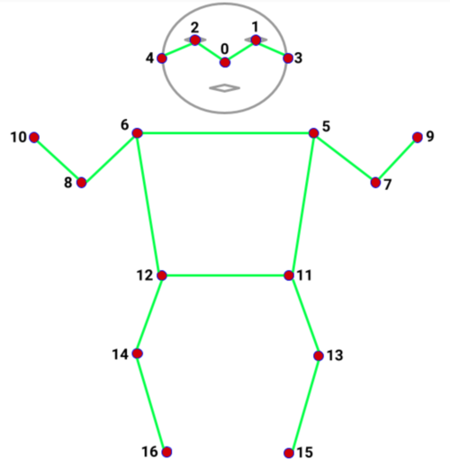

Slide 16
What is the applicability
Realtime pose detection

Slide 17
HOW?

Slide 18
Using Machine Learning
Training a model
Using the old data to correct the pose
Using classification to identify the model

Slide 19
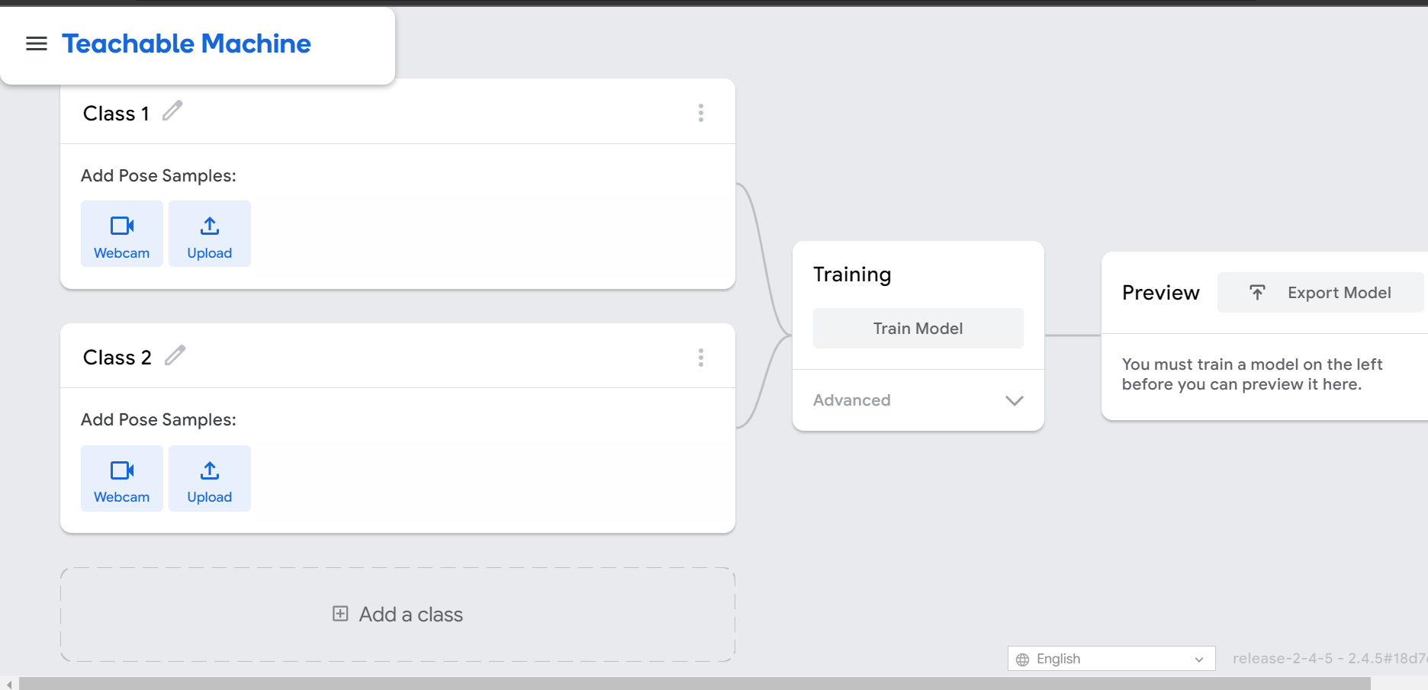
Training the Model – Google Teachable Machine
Image project, Audio Project, Pose Project
Lets you use multiple class for classification and trained model can be downloaded.
Download as model_meta.json, model_weight.bin, model.json

Slide 20
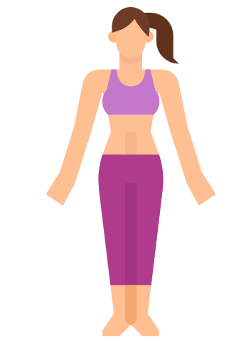
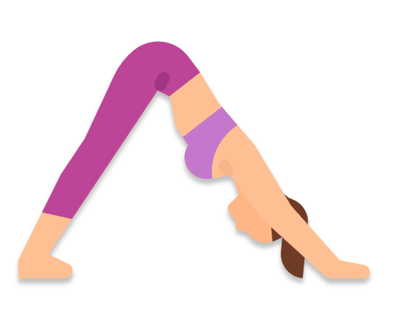
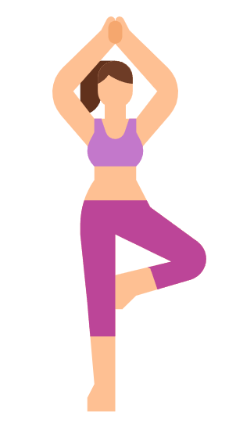
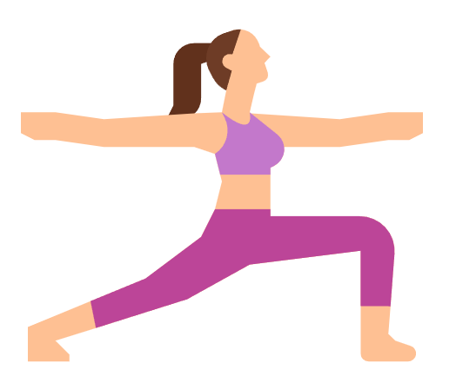
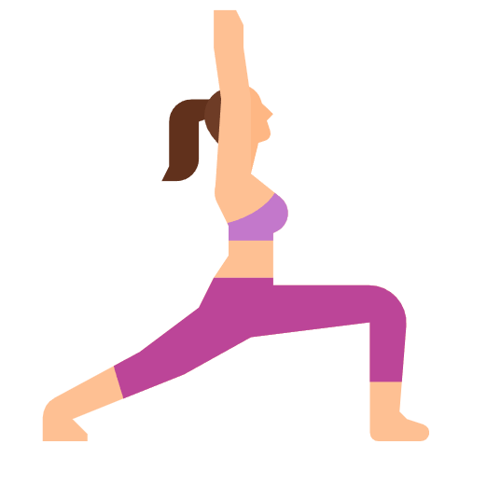
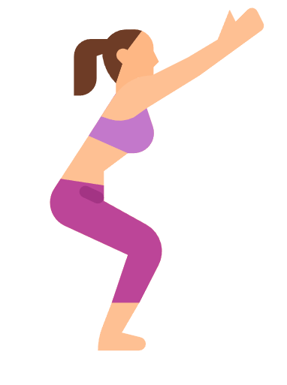
What are we gonna train it on?
Vrksasana
Tadasana
Adho Mukha Shvasana
Virabhadrasana 2
Utkatasana
Virabhadrasna

Slide 21
How to used the trained model
First We are going to create a neural network for classification. There are multiple option for its initialization. We are just going to use 4 main argument.
1. inputs: 34 (pose net detects 17 points so, it’s x,y coordinated will make the input as 17*2)
2. Output: 6 (no of poses we want to classify)
3. Task: Classification
4. Debug: True

Slide 22
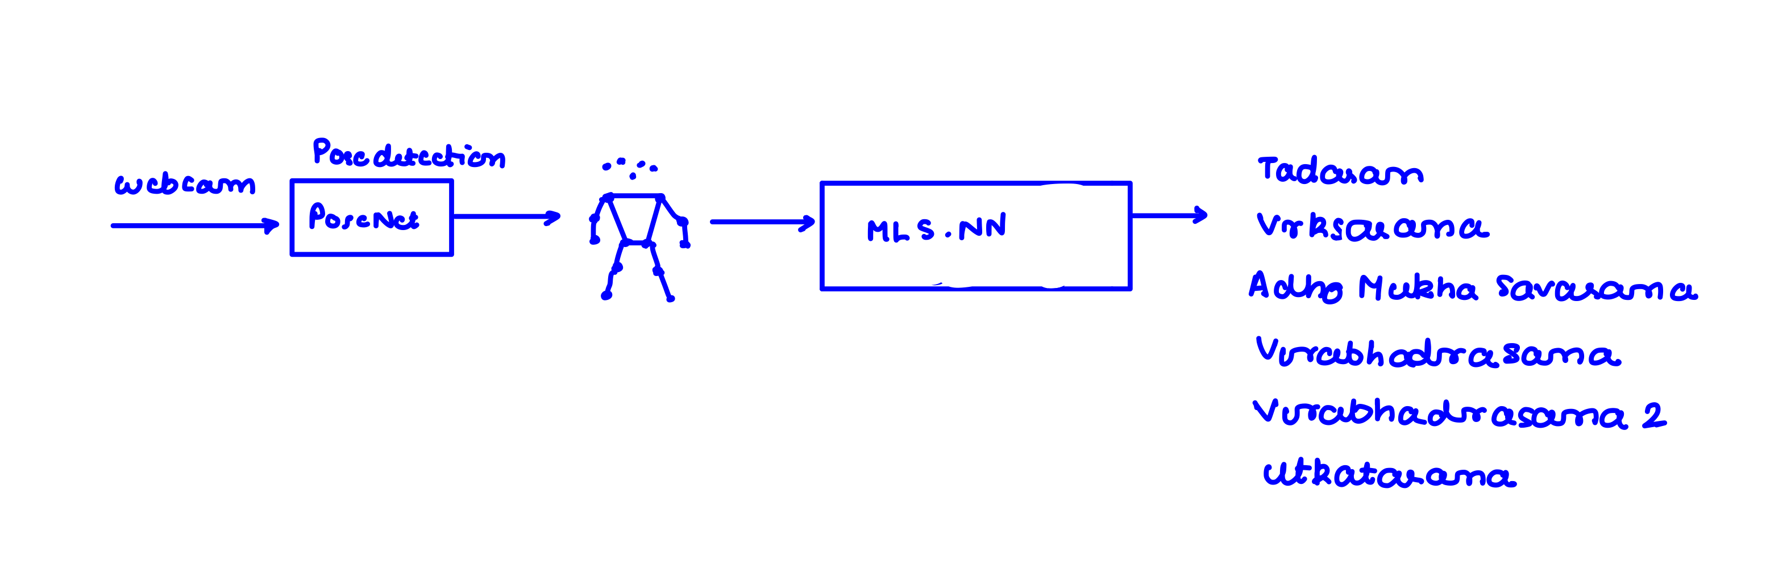
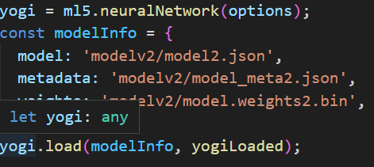
How it works?
We will import trained model using load function

Slide 23
How it works (contd.)
Ml5_neural_network_name.classify() – arguments
1. inputs (same poses variable x,y coordinated used to draw skeleton)
2. gotResult function as callback
GotResult has 2 parameters
1. error
2. result

Slide 24
Program Logic
Important Variable | Task Assigned to them
Posecounter | For keeping track of how many poses has been done
Target | Name of the ongoing pose
TImeLeft | Virtual counter
Errorcounter | To keep tracks of error
Iteration counter | Keep track of timer to change position

Slide 25
Program Logic (contd.)
Function | Major Task
Setup | Initialization function
Yogiloaded(), modelLoaded() | Console message function
ClassifyPose() | Initial function to which we are going to keep looping back to
GotResult() | Will contain main logic of the program
gotPoses | When pose is detected
Draw | For skeleton drawing
nextPose() | To make change to html element in webpages using DOM

Slide 26
RULES for gotResult()
Criteria for judgement: confidence score> 70%
Then we will check if the user is doing the pose we are asking him to do until counter hits zero
1. Yes: continue
2. else:
1. error counter > 4: timeout, restart detection
2. else : timeout
Then we will check if the detection is the 10 iteration of correct detection
1. Yes: reset counter, next pose
2. else: Decrease Time, count iteration and then timeout

Slide 27
Next Pose
Restart the counter timings
Here we will first check how many poses we have done .
if poses>5: Greet user
else: Change the pose name and pose image on screen and timeout

Slide 28
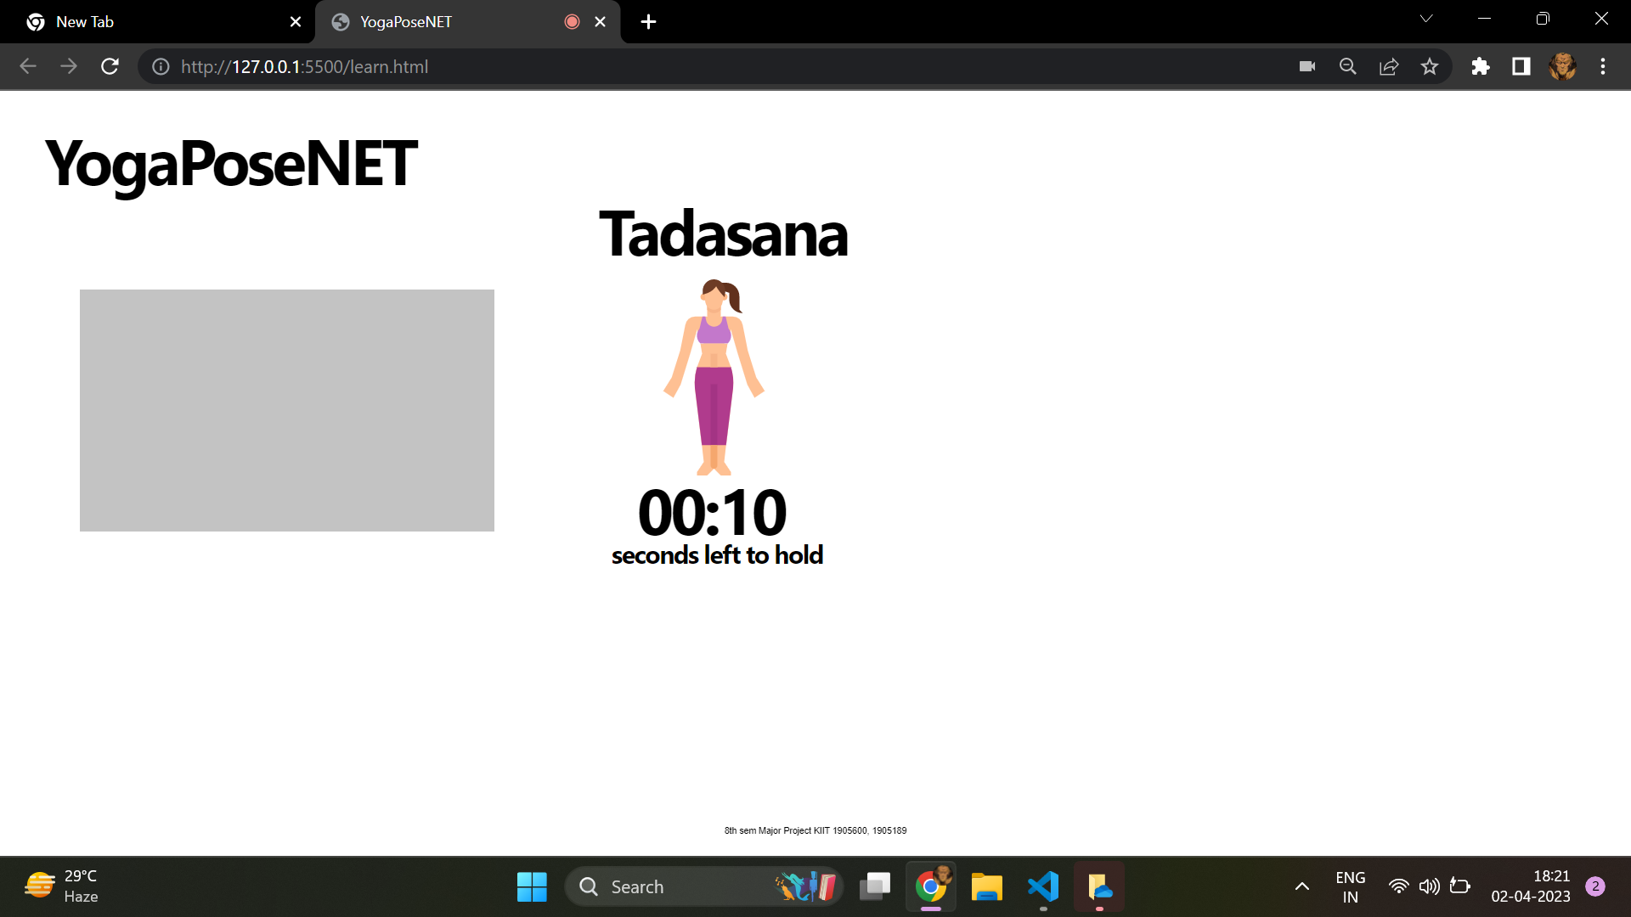
Greeting Screen

Slide 29
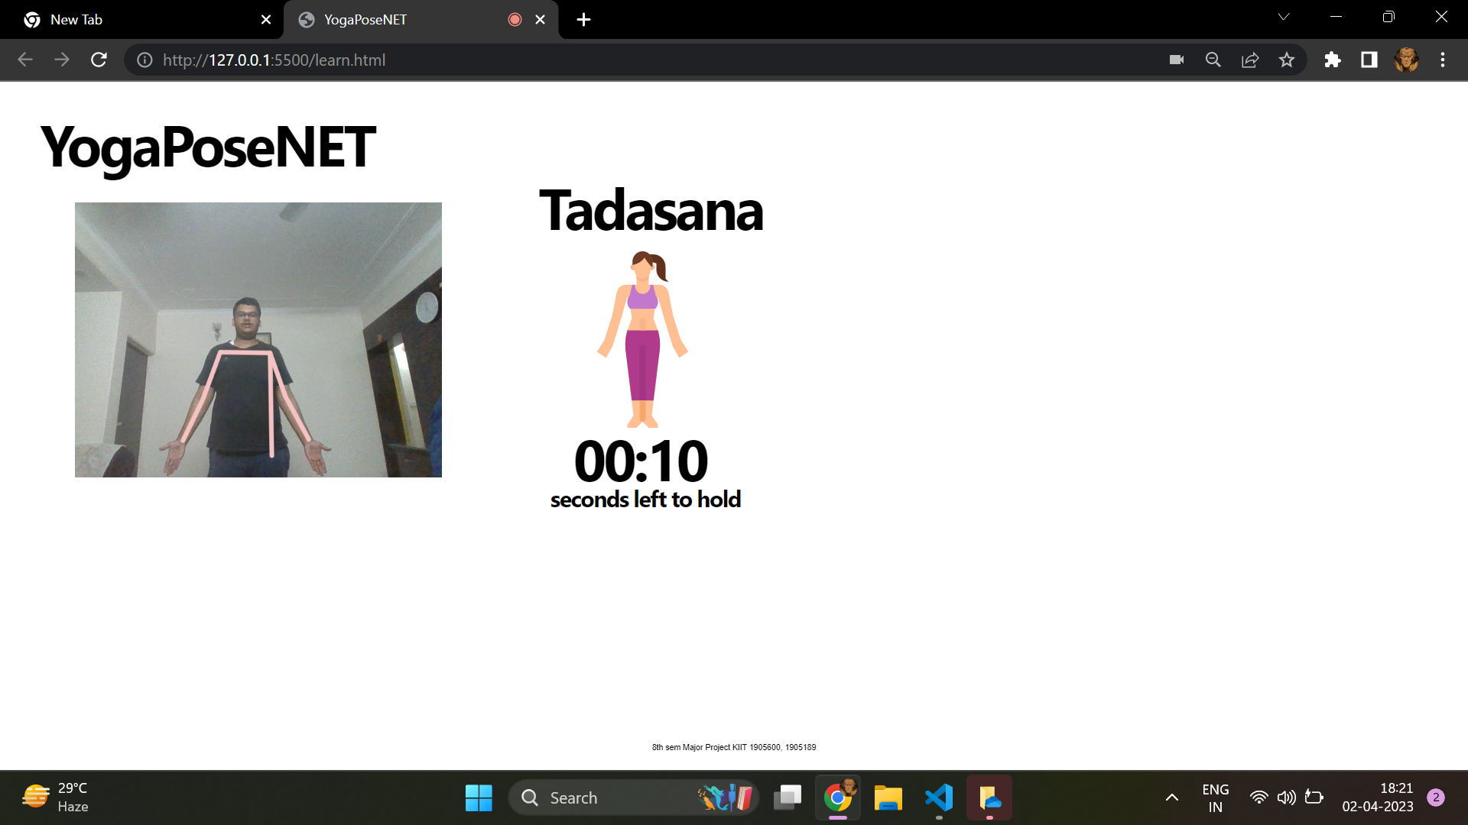
Tadasana

Slide 30
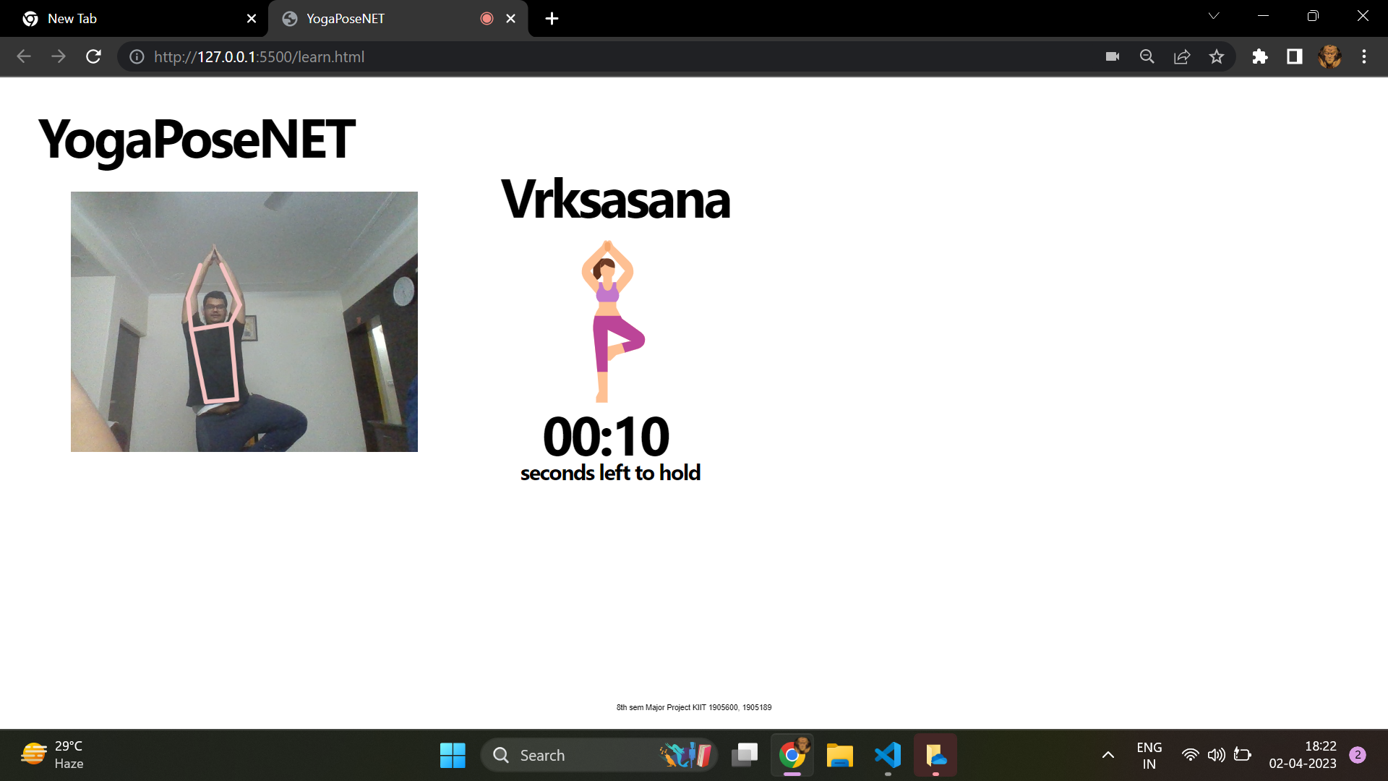
Vrksasana

Slide 31
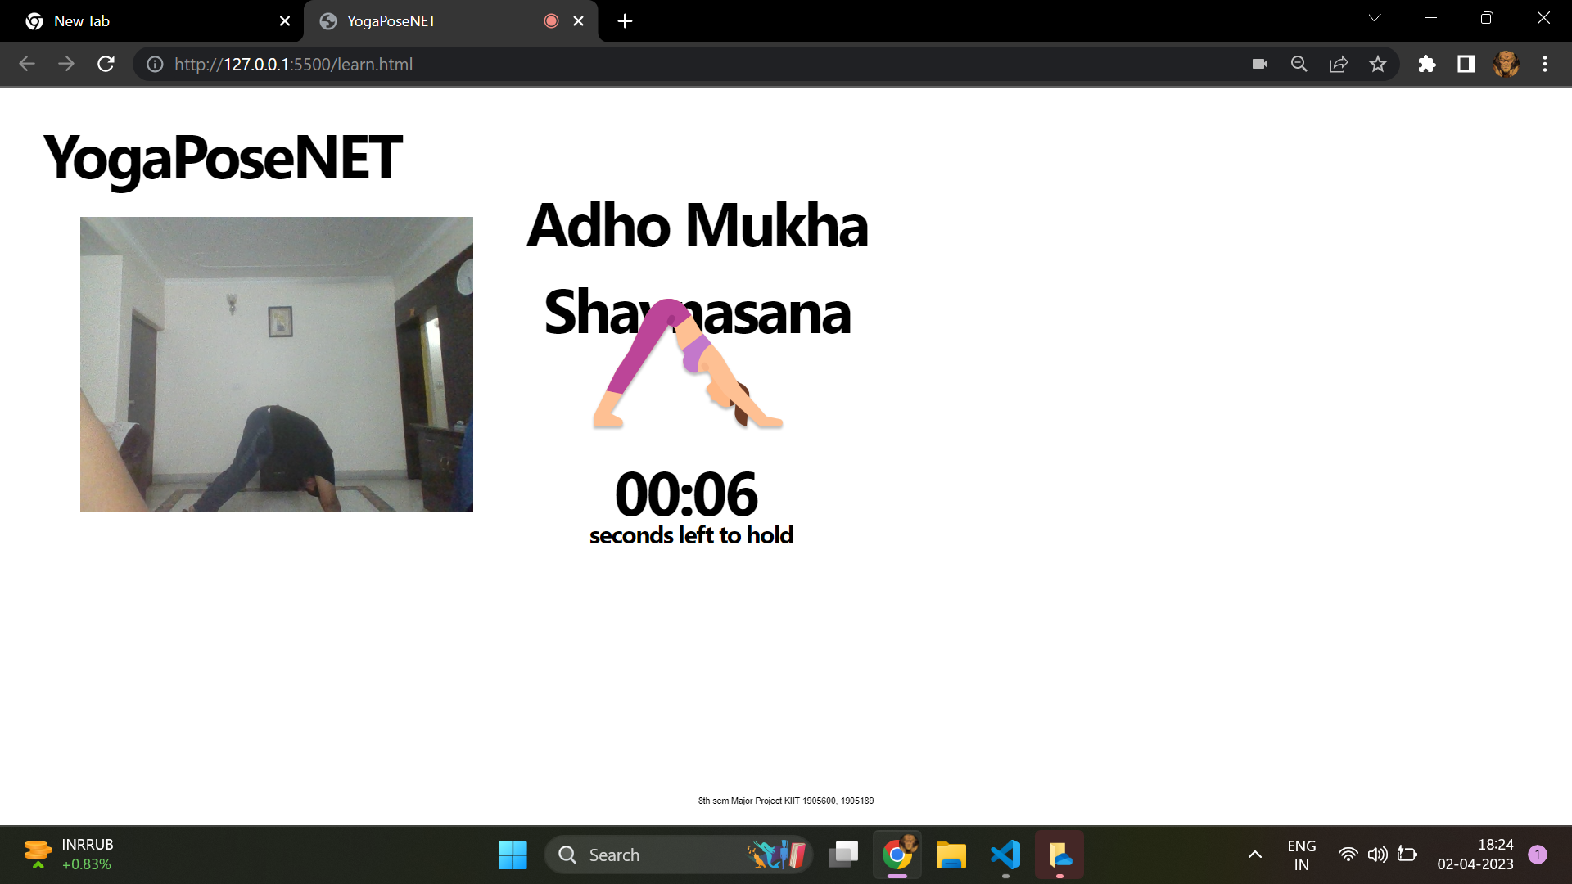
Adho Mukha Shavasana

Slide 32
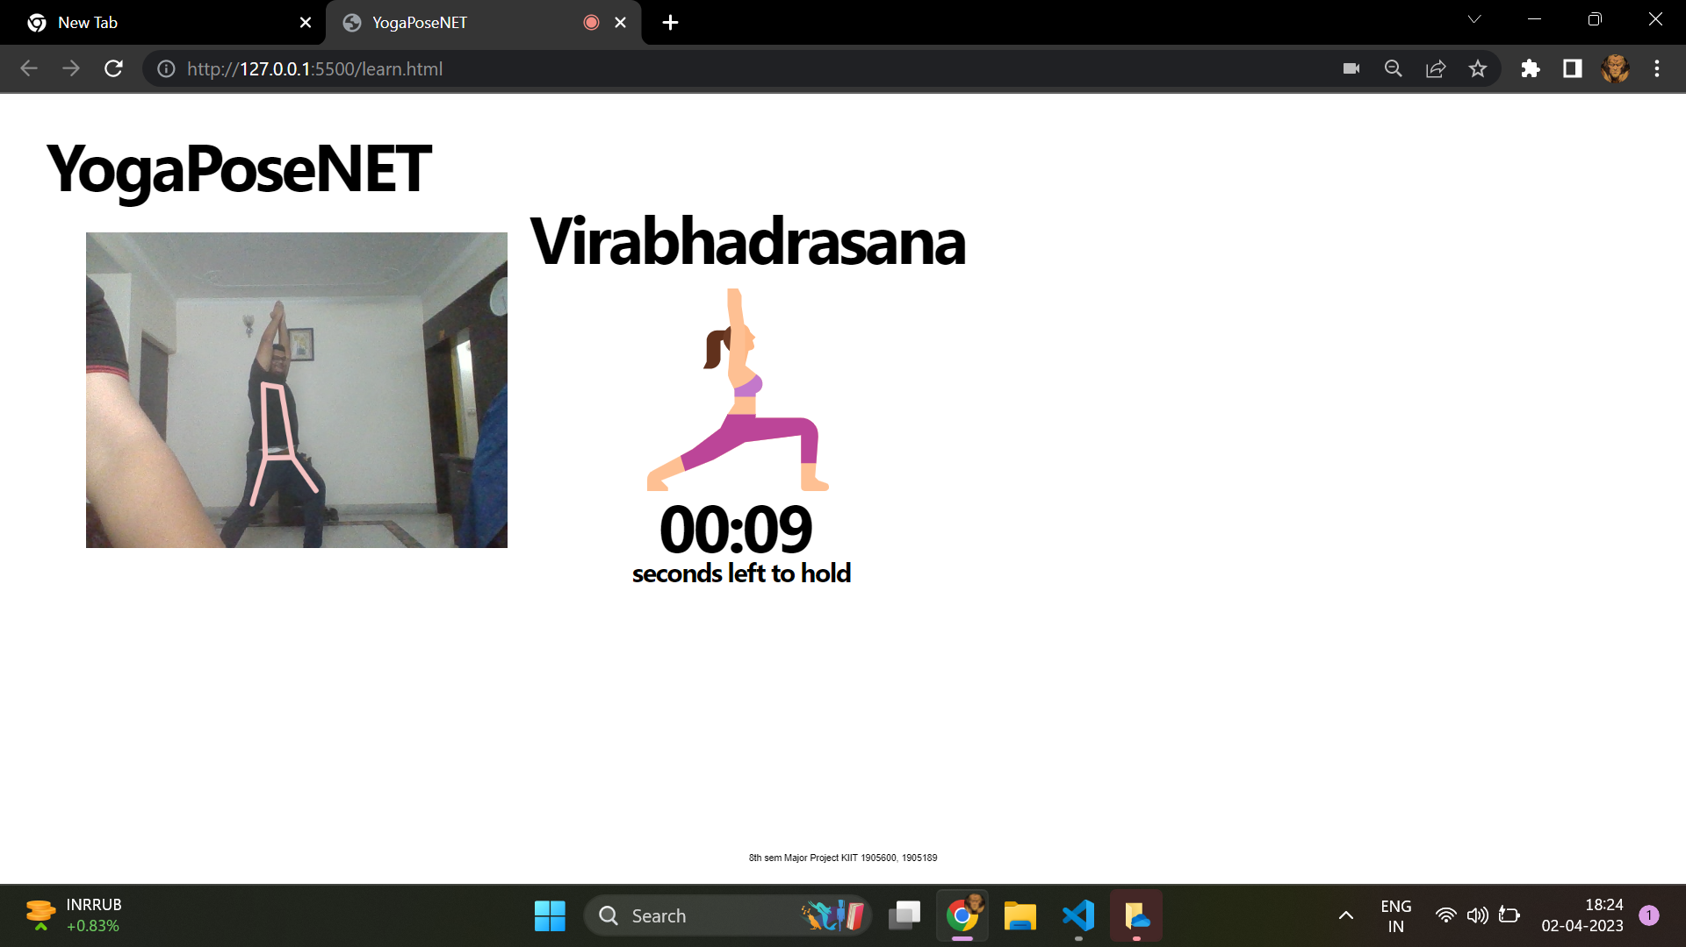
Virabhadrasana

Slide 33
Virabhadasana 2

Slide 34
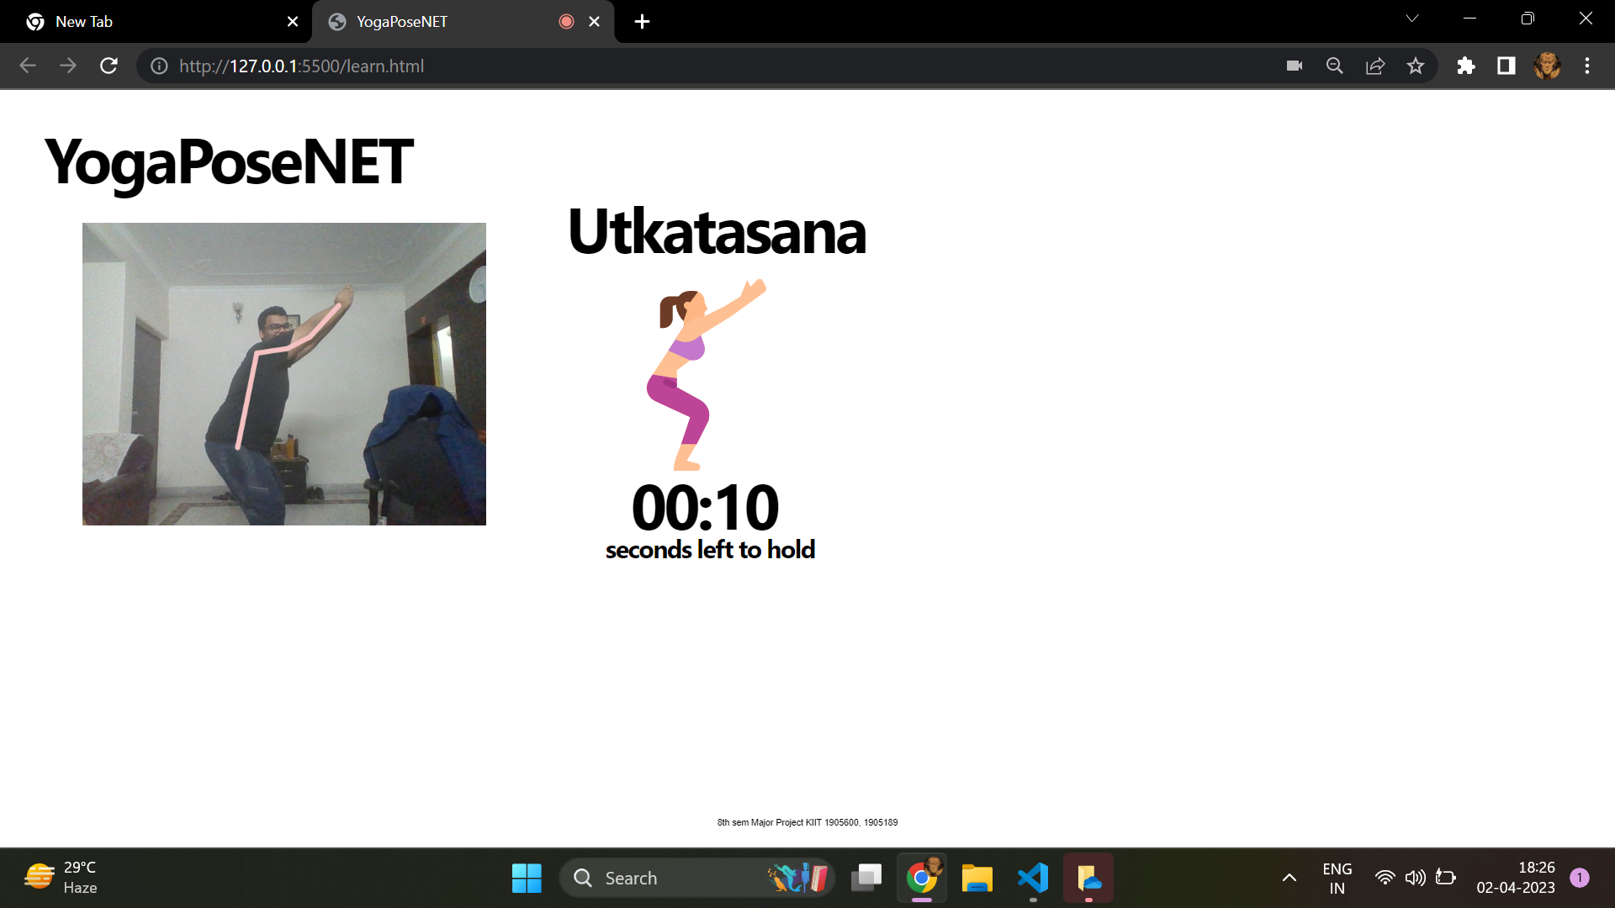
Utkatasan

Slide 35
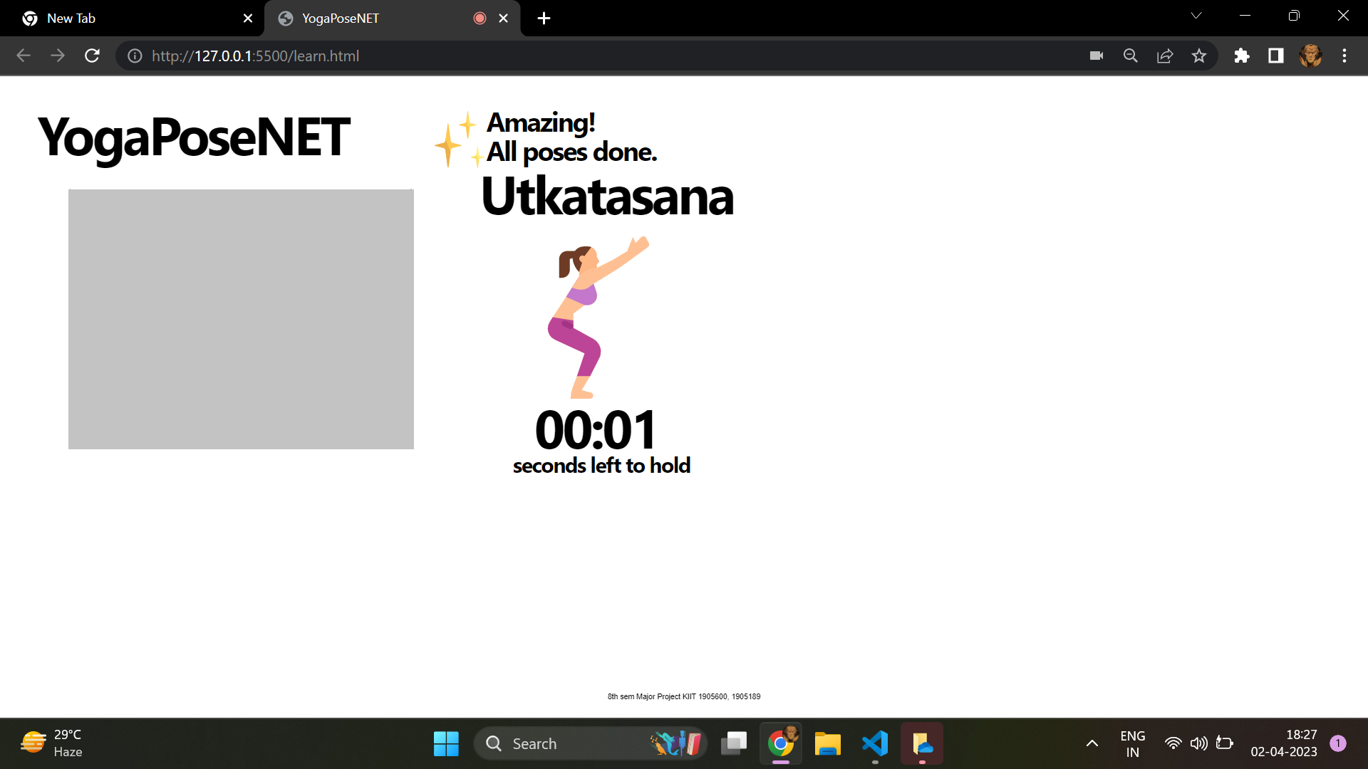
All poses done

Slide 36
THANK YOU

